Slide 1
IS4432 Systems Design
Week 13: Conversion Strategies & Change
Adapted by Janet Yu
115/11/07

Slide 2
Agenda
Implementing Change
Conversion Strategies
Change Management
Post-implementation Activities
115/11/07

Slide 3
Implementing Change
Transitioning to new systems involves managing change from pre-existing norms and habits.
Change management involves:
  Unfreezing -- loosening up peoples’ habits and norms
  Moving -- transition from old to new systems
  Refreezing -- institutionalize and make efficient the new way of doing things
115/11/07

Slide 4
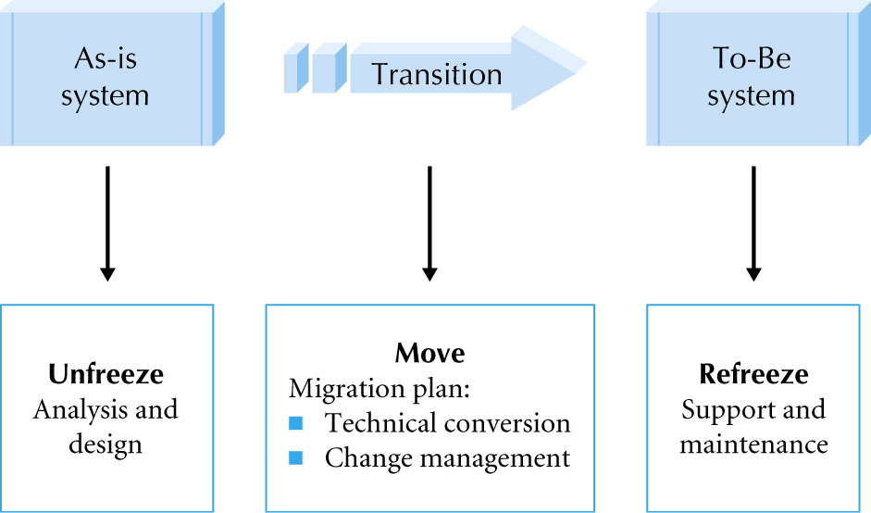
Implementing Change
115/11/07

Slide 5
Unfreezing
Unfreeze current habits and norms by
  Informing users of the new system
  Involving key users in the analysis phase
  Involving key users in the design phase
115/11/07

Slide 6
Migration Planning
Moving people from As-Is system to To-Be system by
  Installing hardware and software
  Converting data – can be very complicated
  Training users on the system
  Motivating employees to use the new system to aid in their work
115/11/07

Slide 7
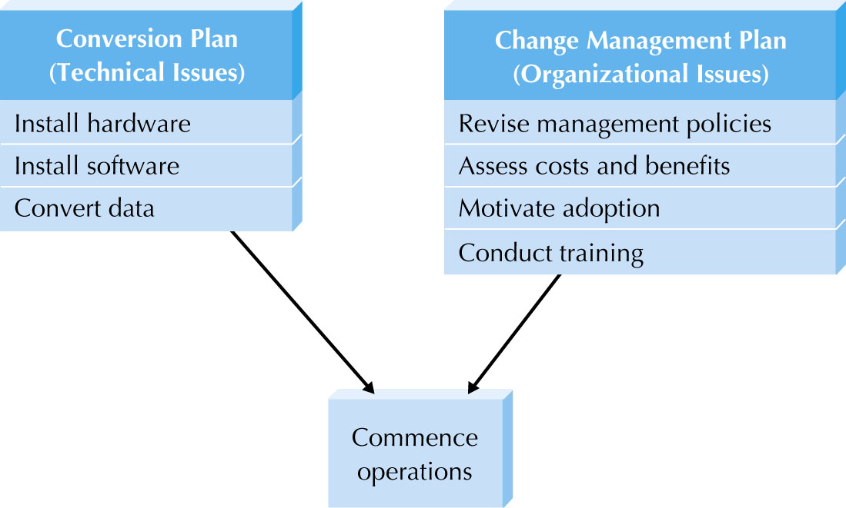
Elements of a Migration Plan
115/11/07

Slide 8
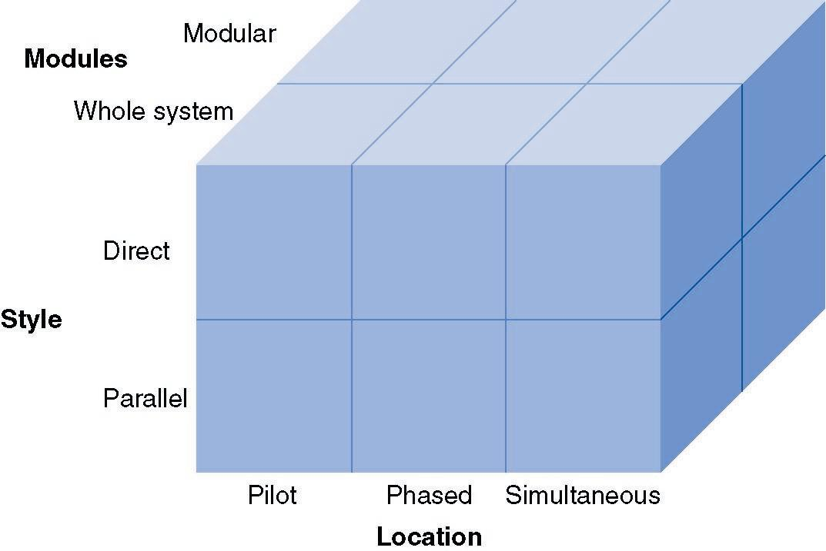
Conversion Strategies
115/11/07

Slide 9
Conversion Styles
Direct conversion
  Cold Turkey, Big Bang, Abrupt Cutover
  The new system instantly replaces the old
Parallel conversion
  Old and new systems used side by side
  Old is turned off when new is shown to work
115/11/07

Slide 10
Conversion Location
Pilot conversion
    A few locations are converted first
    Once bugs are worked out, other locations are converted
Phased conversion
    Partition the organization
    Convert each partition one at a time
Simultaneous conversion
    All locations are converted at the same time
    Can be used with direct or parallel conversion
115/11/07

Slide 11
Conversion Modules
Modular conversion
  Separate modules are converted one at a time
Whole system conversion
  All modules converted in one step
115/11/07

Slide 12
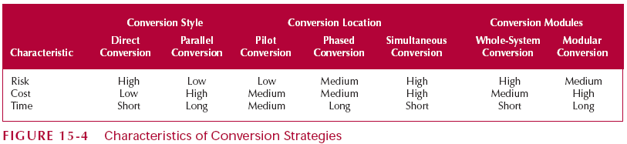
Exercise: Comparing Conversion Strategies
Each group evaluate a conversion strategy with reference to alternatives in the same category. Rate ‘High/Medium/Low’ or ‘Long/Medium/Short’ for each characteristics. Present your findings to the class.
115/11/07

Slide 13
Change Management
Conversion was the technical aspect of moving to the new system
Change management is the organizational aspect of moving to the new system
115/11/07

Slide 14
Key Players in Change Management
The sponsor
  The person who initiated the request for the new system; usually senior management
The change agent
  The person who plans and implements the change
Potential adopter(s)
  The people that the new system is designed for
115/11/07

Slide 15
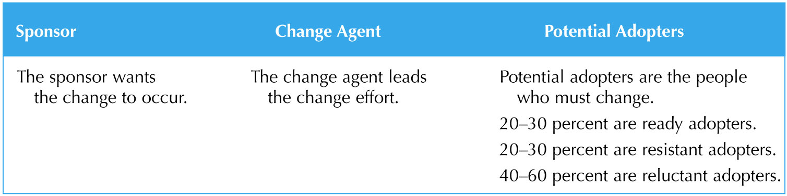
Actors in the Change Management Process
115/11/07

Slide 16
Resistance to Change
Good for the organization
≠
Good for individual workers
Workers perform their own cost/benefit analysis based on their perceptions
115/11/07

Slide 17
Ways to Manage Change (1)
Setup or revise management policies
  Provide goals
  Define work processes - Standard operating procedures (SOPs)
  Determine measurement and rewards
115/11/07

Slide 18
Ways to Manage Change (2)
Motivating Adoption Strategy
  Informational Strategy
    Convince adopters that the change will benefit them
    Write memos and hold seminars to sell the new system (similar to an advertising campaign)
  Political Strategy
    Organizational power is used to motivate change
    Used when costs outweigh benefits for individuals
    “Adopt the system or you are fired”
    Requires someone who holds legitimate power
115/11/07

Slide 19
Ways to Manage Change (3)
Enable Adoption by providing training
  Users must be capable of adopting the system as they may need new skills
  Use cases are a good place to look to see what to train
115/11/07

Slide 20
How to Train
Classroom Training
  Creates a shared experience among users
  Efficient use of resources
One-on-One Training
  Expensive but has most impact on users
  Meets individual’s needs
  Used for important users or when there are very few users
Computer-Based Training (CBT)
  Expensive to develop but cheap to deliver
  Greatest reach but has least impact on users
115/11/07

Slide 21
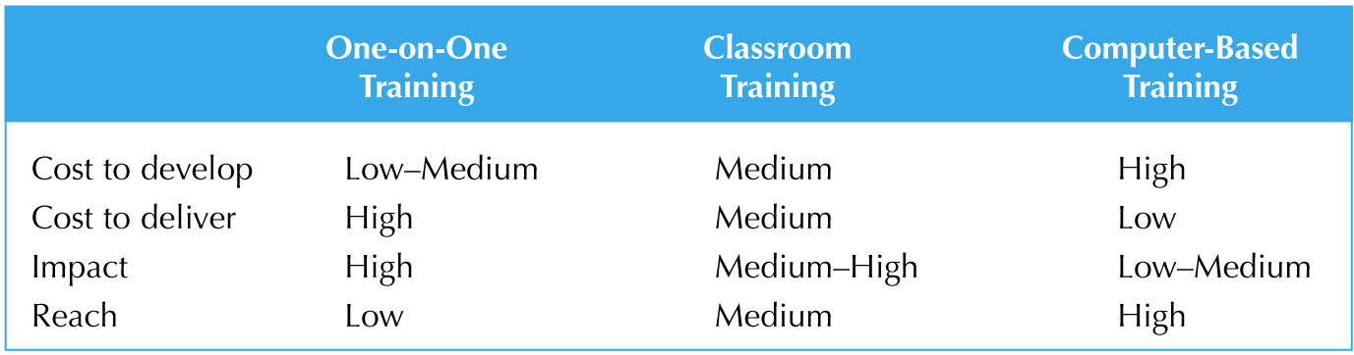
Selecting a Training Method
115/11/07

Slide 22
Post-Implementation Activities
Make the new system the normal, routine, accepted way of doing business
Key activities:
  System support
  System maintenance
  Project assessment
115/11/07

Slide 23
System Support
The Operations Group is responsible for running the system post-installation
Types of system support
  On-demand training
  Online support
  Help desk
    Level I support should satisfy 80% of problems
    Level II support staff address the remaining problems after a Problem Report is filled out by level I
115/11/07

Slide 24
System Maintenance
The process of refining the system to make sure it continues to meet business needs
More expensive than initial development
Change requests are smaller versions of a system request
115/11/07

Slide 25
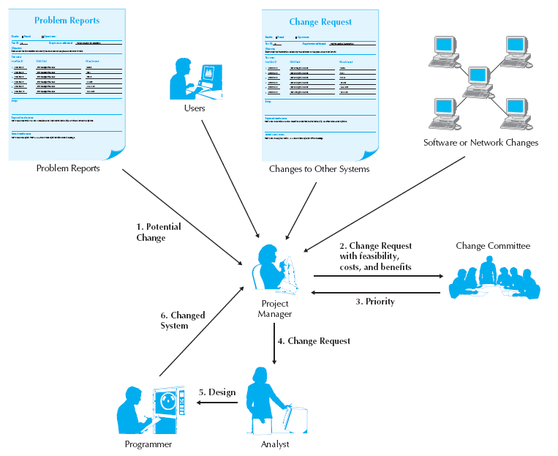
Processing a Change Request
115/11/07

Slide 26
Project Assessment
To understand what was successful about the system and the project activities
  Project team review
    Prepared by team members
    Focused on improvements
  System review
    To understand the extent to which the proposed costs and benefits from the new system were actually recognized.
115/11/07

